Slide 1


Movie Ticket Booking System
PRESENTED BY :
Deepak Harish TM
Sachin R

Slide 2

CONTENTS
1. Project Objective
2. Technologies & Structure
3. Admin Functionalities
4. User Functionalities
5. Booking & Seat Management
6. Snack Management & Revenue
7. Search & Convenience
8. Challenges & Future Enhancements

Slide 3


01
Project Objective

Slide 4
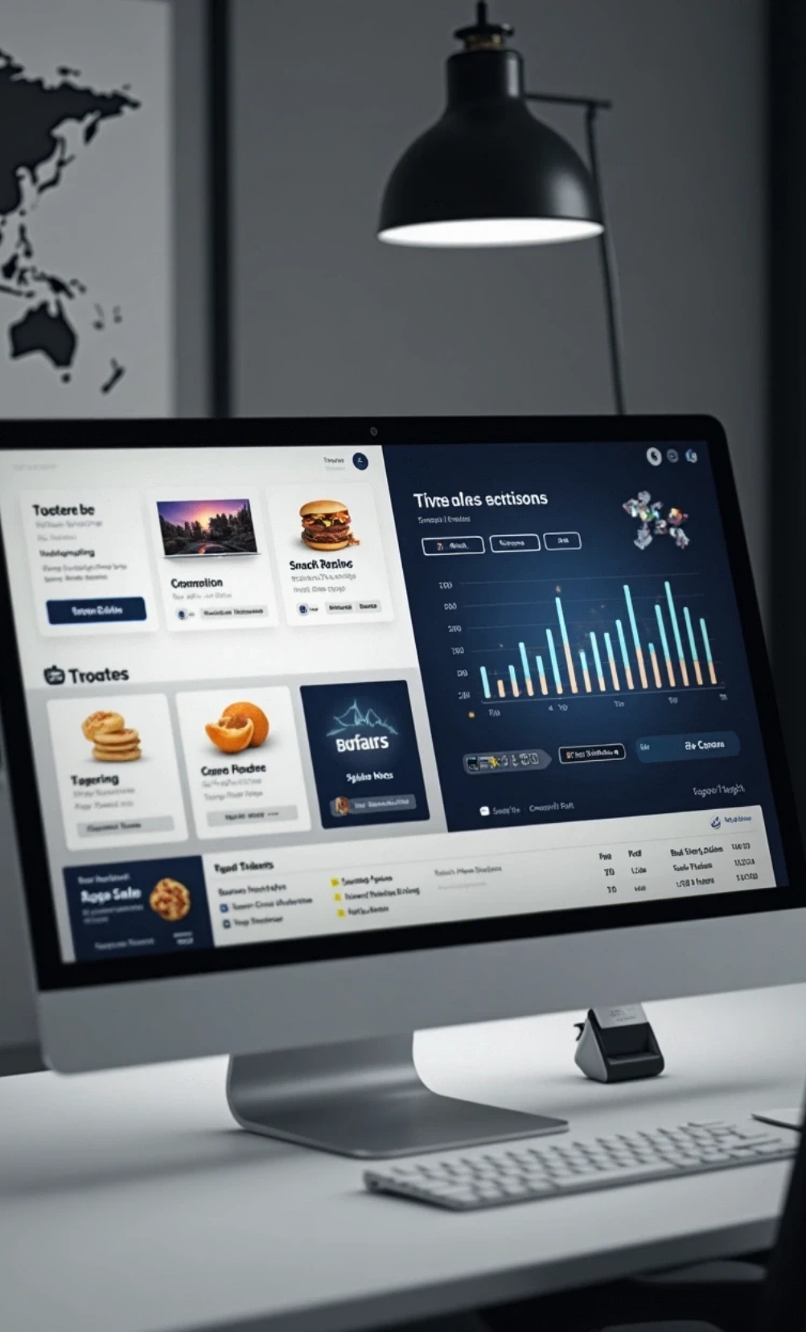
Objective
Enable admins to manage theatres, screens, movies, and snacks.
Allow users to book/cancel tickets and buy snacks.
Track ticket and snack revenue.
Provide search functionality for theatres and movies.
Console-based interactive system.

Slide 5

02
Technologies & Structure

Slide 6
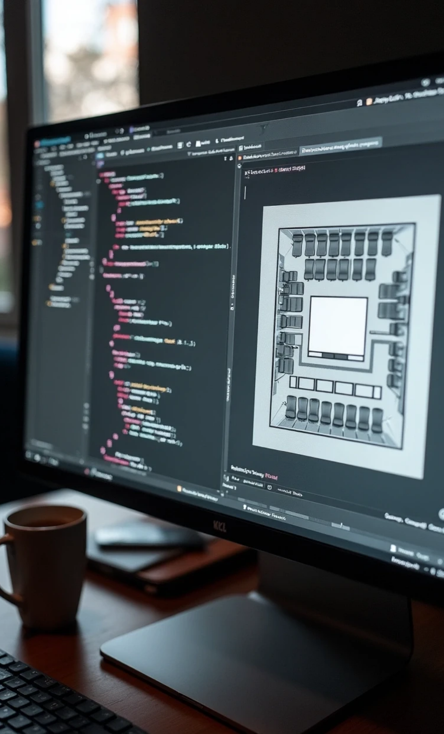


Tech & Project Structure
Language: Java
Data Structures: ArrayList, 2D Arrays
Classes: MovieBooking, Screen, Theatre, Snack, User, MultiTheatreBookingSystem
Encapsulation, OOP concepts, modular design.
Scanner-based console input/output.
Dynamic management of seats and snacks.

Slide 7

03
Admin Functionalities

Slide 8
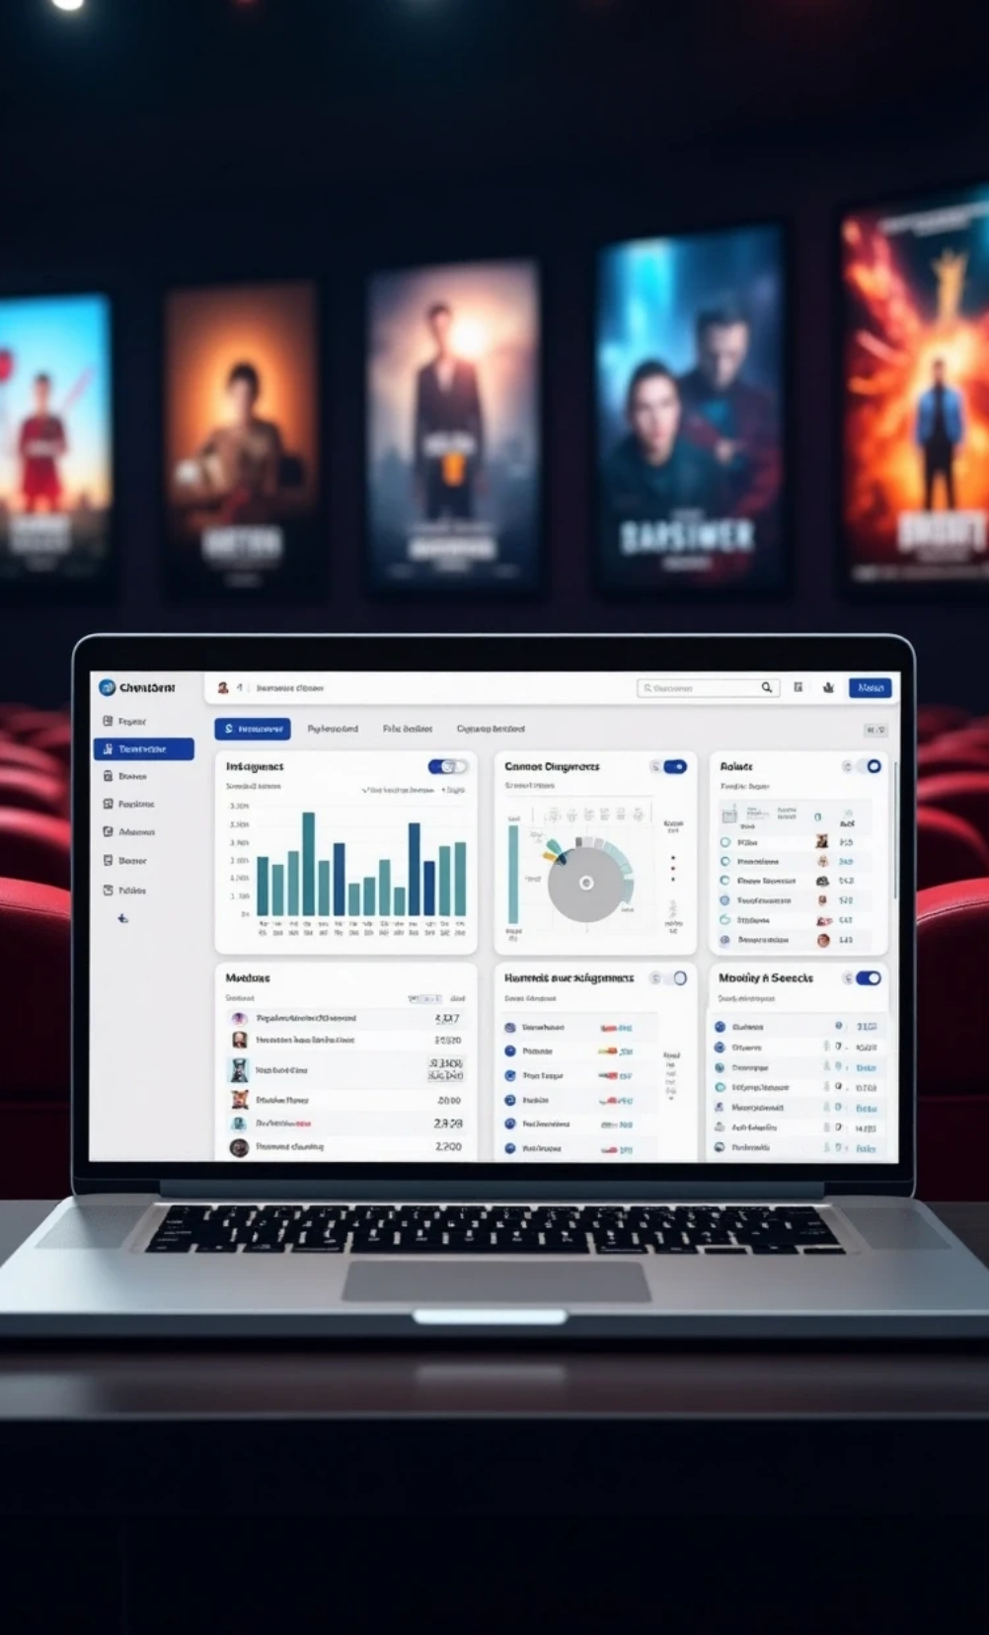


Admin Features
Add/Delete theatres, screens, and movies.
Add/Delete snacks.
View total revenue (movies + snacks).
Search theatres or movies.
Easy management via console menu.

Slide 9

04
User Functionalities

Slide 10
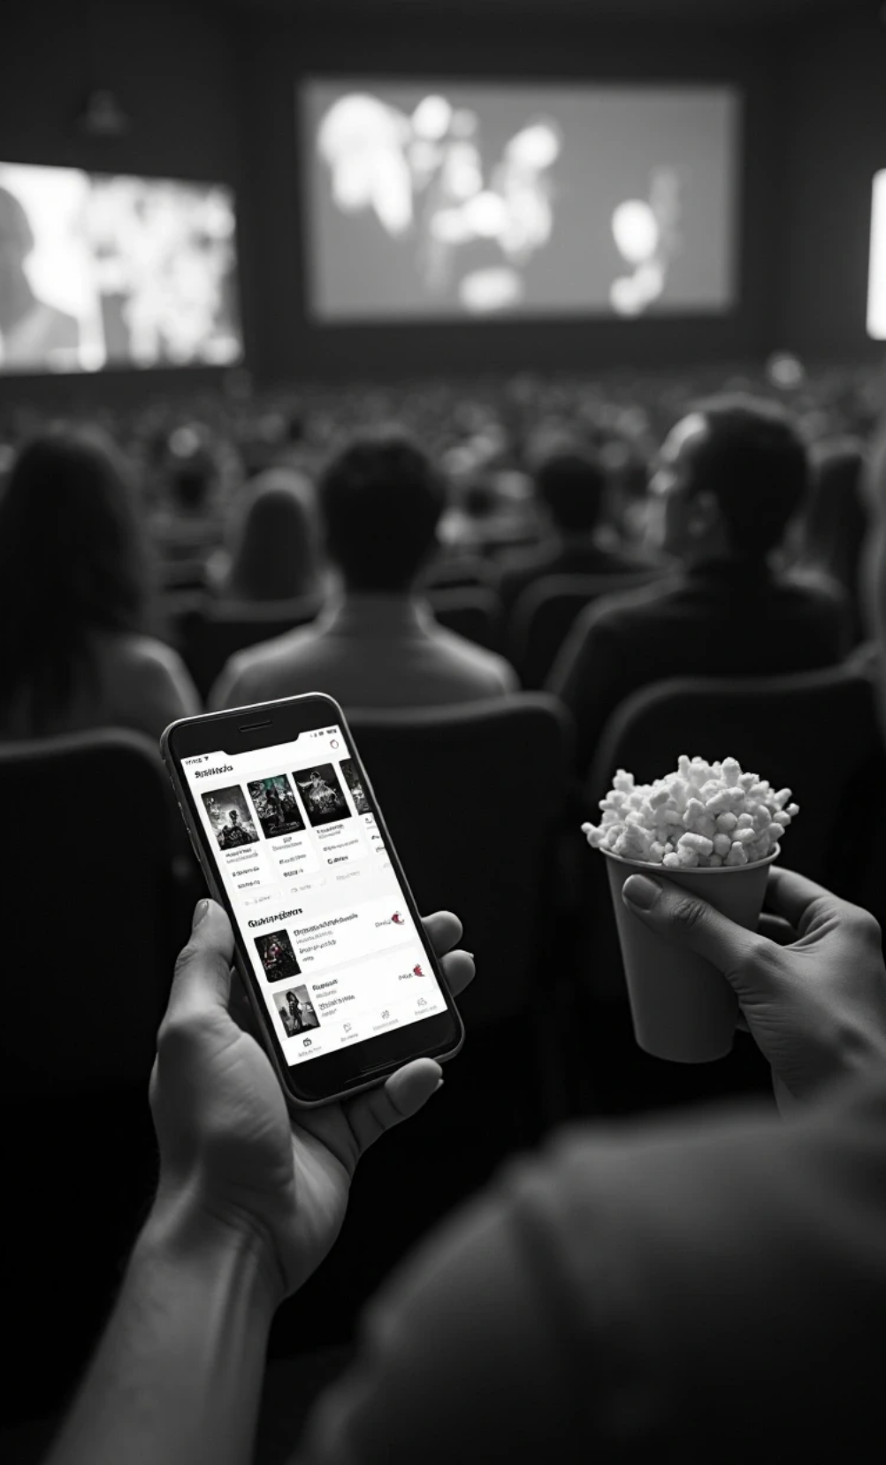
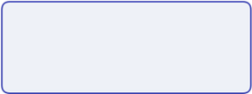

User Features
Register/Login.
View theatres, screens, and movies.
Book and cancel tickets with seat selection.
Buy snacks (small, medium, large).
Search movies/theatres for booking.

Slide 11

05
Booking & Seat Management

Slide 12
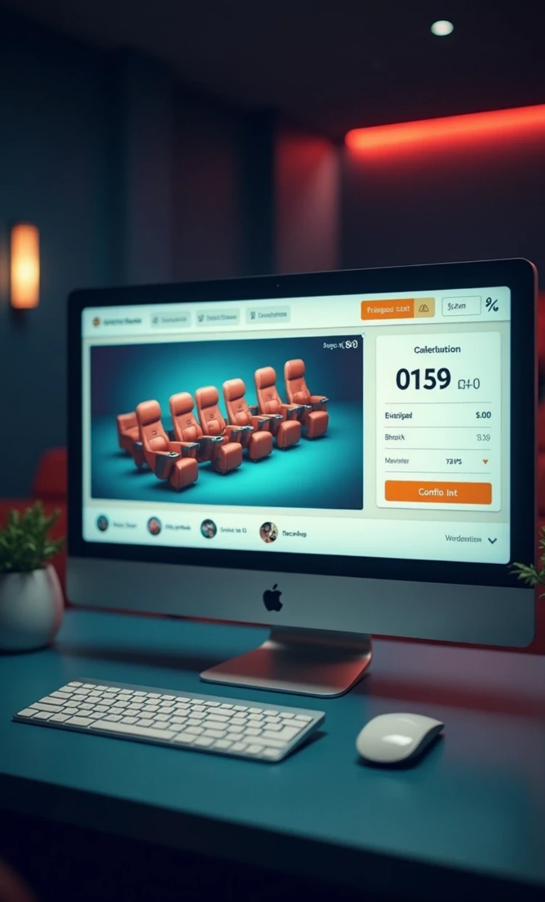
Ticket Booking Flow
User selects theatre and screen.
Movie seat layout displayed (booked seats marked [X]).
Users choose seats; invalid/occupied seats handled.
Tickets stored in user profile.
Total cost displayed, revenue updated.

Slide 13

06
Snack Management & Revenue

Slide 14

Snacks & Revenue
Users select snacks and size; price added to total.
Snack revenue tracked separately.
Admin can add/delete snacks.
Revenue = Movie revenue + Snack revenue.
Helps monitor theatre business performance.

Slide 15

07
Search & Convenience

Slide 16
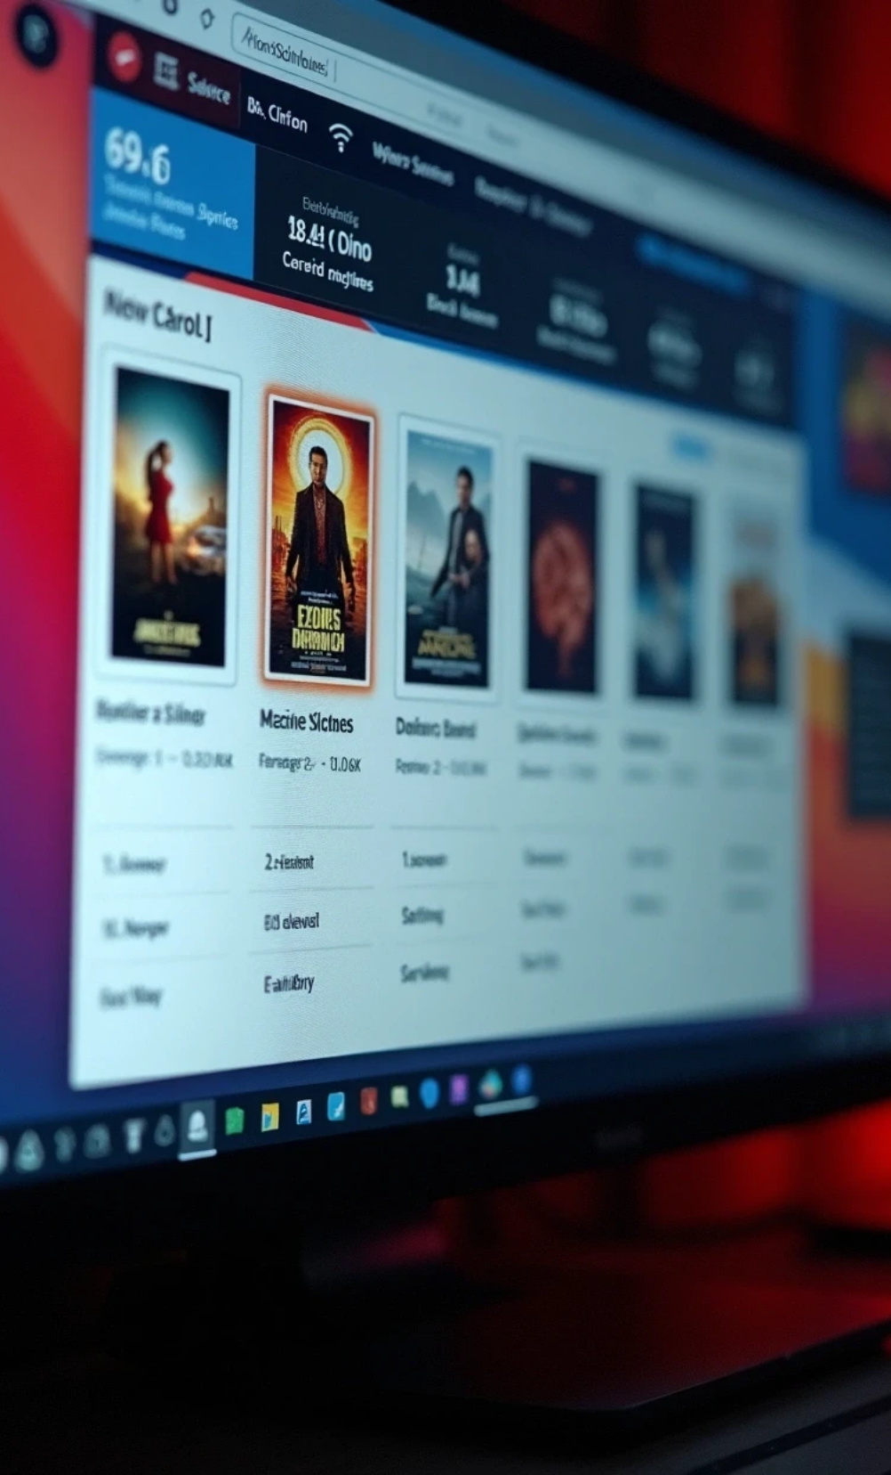
Search Functionality
Search by movie or theatre name.
Shows available screens and seats.
Users can directly book from search results.
Admins can search to add new movies.
Improves usability & quick access.

Slide 17

08
Challenges & Future Enhancements

Slide 18

Challenges & Future Scope
Challenges: Managing dynamic bookings, multiple theatres, revenue tracking.
Learning: OOP, data structures, console interaction, modular design.
Future Enhancements: GUI version (JavaFX/Swing), online payments, notifications, database integration.

Slide 19

Thank You

